Slide 1
Teaching Scientific Publishing Literacy as a Special Topics Course
Kim Reycraft
STEM Librarian, Florida Gulf Coast University
2022 STEM Librarians South conference

Slide 2
Background
Spring 2021 – Presentation on Open Access publishing and Data Sharing for 1-credit Special Topics graduate course, Global Change Biology in the MS Environmental Science program
“It seems like graduate students are expected to have a working knowledge of these issues without receiving any formal training.”

Slide 3
From a “One Shot” to a Course
Adding required courses and/or electives requires planning and approvals
Reluctance to add more required courses for degree completion
Curriculum committees, university administration, etc.
One-credit Special/Current Topics courses are more flexible
Required for M.S. in Environmental Science
Pitching the course
Relationships with department chairs key

Slide 4
The Course
Scientific publications
Literature reviews
Submitting a paper
Evaluating journals
Peer review process
Dealing with decision letters
Measuring research impact
Author’s rights
Open access publishing
Avoiding predatory journals
Research data management
Researcher profiles
Issue, controversies and ethics
Future of scientific publishing
Weekly readings and resources
Required discussion board posts
Student-led discussion

Slide 6
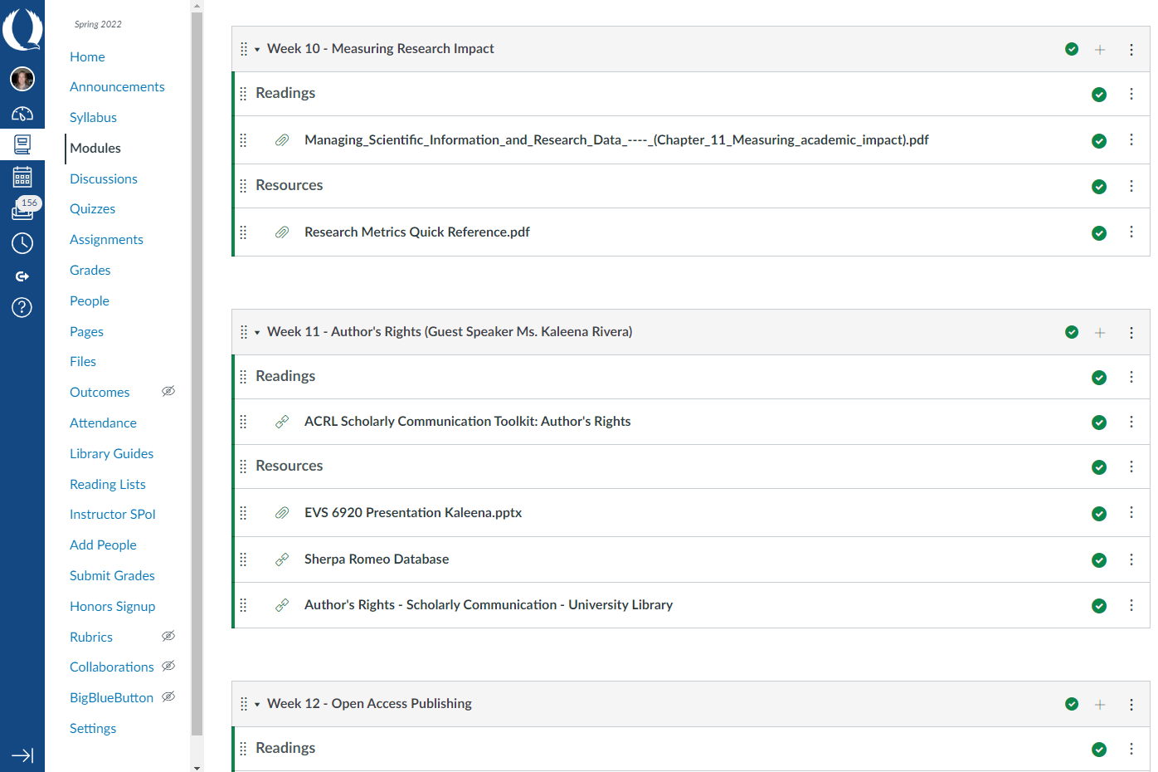

Slide 7
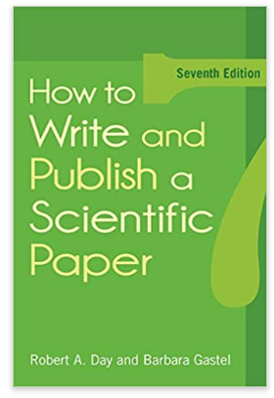
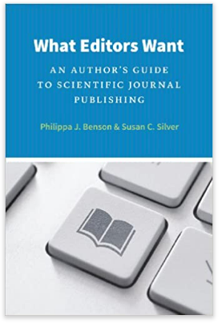
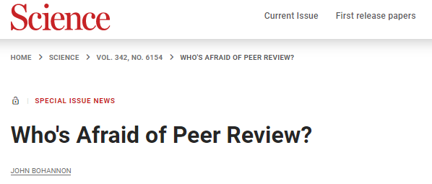
Readings
No required texts.
Variety of library-licensed book chapters, articles and websites.

Slide 8
Resources
Zotero
Journal Citation Reports
Cabell’s Journalytics and Predatory Reports
Sherpa Romeo Database
Directory of Open Access Journals
Publons
DMPTool
Re3data.org
Dryad Data Repository
Open Science Framework
ResearchGate
Journal of Visualized Experiments (JoVE)

Slide 9
What went well?
Students very engaged, collaborative and respectful
Content on point
12/15 seats filled
Discussed student scholarship
Favorite readings and discussions:
Author’s rights
Avoiding predatory journals
Researcher profiles
Future of scientific publishing

Slide 10
What could have been better?
Not enough work
Low-effort discussion posts
Confusion over leading a discussion
Overlap with content from other courses/professors
Ethics in scientific publishing
Submitting a paper

Slide 11
Student Feedback
“Should be a required course for all graduate students doing research, and perhaps for undergraduates interested in research.”
Disappointment with in-person-only format
Overall, all were satisfied or highly satisfied

Slide 12
Next Steps
Continue teaching for Environmental Science MS program
Pitched to Biology MS program
Also required a 1-credit Seminar course
Masters’ in Engineering and Mathematics
Share curriculum and/or create a workshop
Assessment and IRB for publication

Slide 13
My Advice
Build on relationships
Be specific
What will students learn? What problem will it solve?
Share course materials
Invite them to course in the CMS
Be persistent
People are very busy. A polite reminder or second ask will not offend.
Be flexible
Take a chance!

