Slide 1
STEM Workshops
and You
Erin Burns & Jenni Jacobs
STEM Librarians | Texas Tech University
STEM Libs South, July 28, 2022

Slide 2
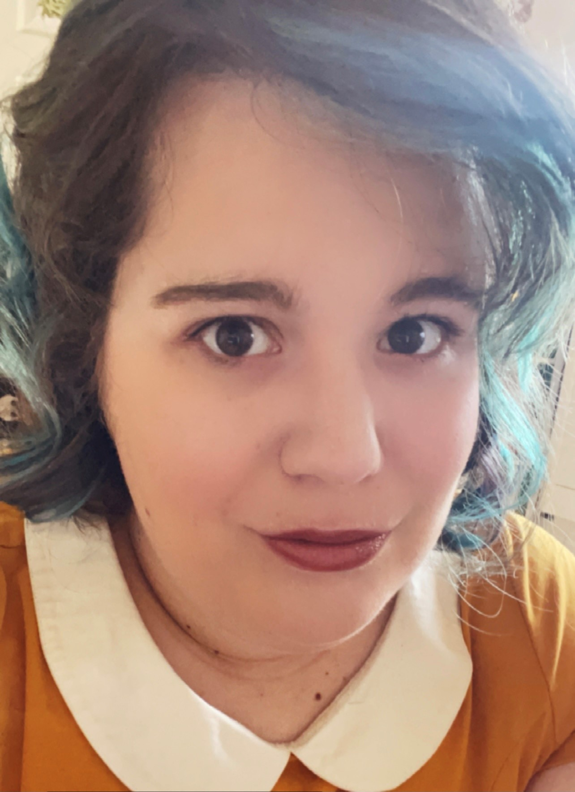
STEM Librarians
Jenni Jacobs
BS, MS, MLIS
STEM Librarian
Texas Tech University
Liaison Areas:
Math and Statistics
Physics
Environmental Toxicology
Forensic Sciences
Geosciences
Kinesiology and Sports Management
Pre-Professional Health
Erin Burns
BA, MLIS, RYT500
STEM Librarian
Texas Tech University
Liaison Areas:
Whitacre College of Engineering

Slide 3
What We’ll Talk About
Why Workshops?
What kinds of workshops we offer
Online Spaces, Lab, Attendance, and Feedback
Structure of Workshops
(Plan, Discover, Analyze, Publish, Impact, Electives)

Slide 4
Why Workshops
Often times professors either don’t know about library instruction, or simply don’t want it (time constraints).
Workshops are a great way to reach students, faculty, and staff in your liaison areas without having to wait for the professor to invite you to the class
Notes:
We’ve all been there, working with professors can be time consuming and hard.

Slide 5
What We Offer!
We offer a range of workshops, from Fake News, to Open Houses, to Systematic Reviews.
Notes:
Erin: STEM specific have included: How to read a scientific paper; APA and Chicago Style for Engineers; Literature Reviews for STEM students; STEM Databases (Web of Science, Scopus and Science Direct); Systematic Reviews; Gale Interactive Chemistry and Anatomy; STEM Analytics and Analytic Tools for Researchers. We have other librarians who have conducted workshops on scientific writing softwares like
The Libraries Makerspace also hosts workshops on software like CAD and AutoCAD and Autodesk Inventor (which is for 3D printing), Inkscape (for the laser cutter) as well as MATLAB, Ryno3D, Python- as well as sewing crochet and knitting workshops.

Slide 6
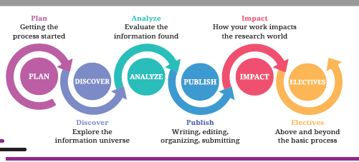
Plan
  Getting the process started
Discover
  Explore the information universe
Analyze
  Evaluate the information found
Publish
  Writing, editing, organizing, submitting
Impact
  How your work impacts the research world
Electives
  Above and beyond the basic process
Notes:
Erin:

Slide 7
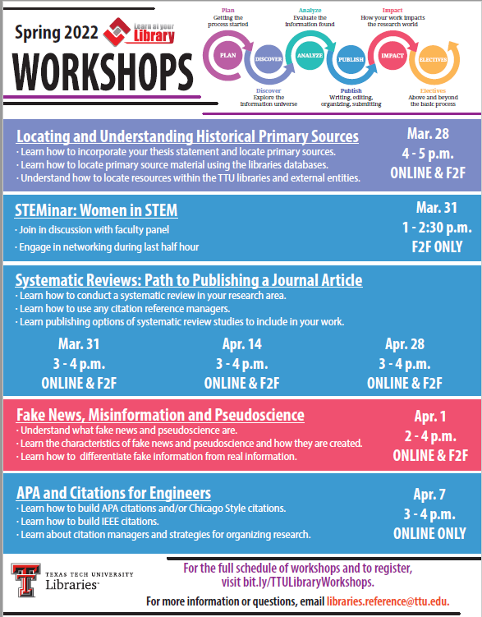
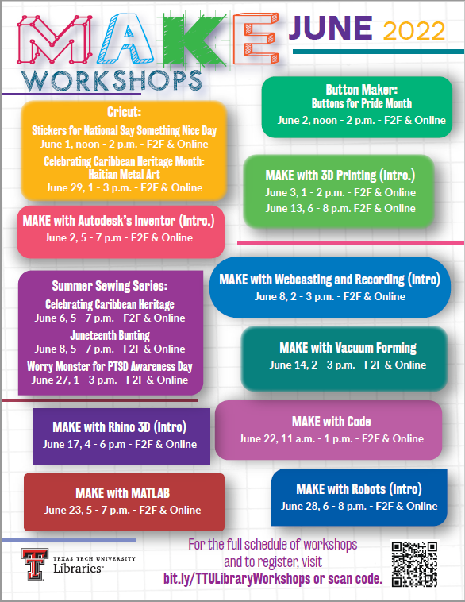
Notes:
Erin: The Makerspace also offers workshops on our library calendar.

Slide 8
Marketing the Sessions
UL Communications and Promotion Dept
Personal Librarians
Extra
Develop the PDF flyers
Announcements in TechAnnounce
Send emails and flyers
Add the LibCal registration link to the emails
Notes:
Erin: Sometimes other departments, like the writing centers and the Graduate School will also send out announcements in their email lists. This is also how Erin has been getting students to attend the yoga sessions she offers on Wednesday evenings.

Slide 9
Structure of Workshops
Co-Teaching
Individual
Subject specific workshops offered alone
The STEM team usually does at least a couple of workshops together

Slide 10
Online Spaces
We do offer workshops both online and in-person. Platforms used:
Zoom
Microsoft Teams
Skype
MediaSite

Slide 11
In-Person Workshops
Brand New Labs
A year in the making, we just got two labs/classrooms in our basement where instruction sessions and workshops are done. These labs include:
Seating for 50+ people
Laptops and desktop computers
Cameras for recording via online platforms
White boards

Slide 12
Photo of lab space

Slide 13
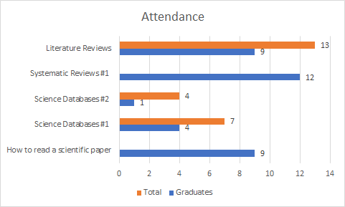
Attendance Stats
For some of the workshops, online was the only presentation but we did see a shortage of people attending in-person

Slide 14
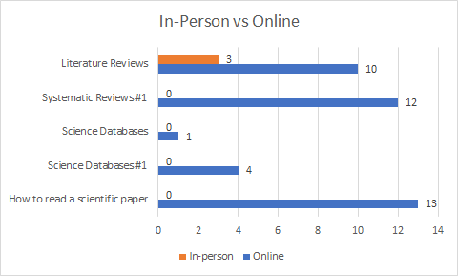
Attendance
Notes:
We don’t have all the information, as the stats are only as good as the people collecting them. When we input our stats into the system, we might not always have a an accurate count of undergraduates and grad students, or sometimes faculty are counted in the total.

Slide 15
Feedback
“Going over each section of scientific paper and then giving the tips how and what to do, so the time is used efficiently”
“The resources that the presenters shared. They were great and I plan to share them with my students.”

Slide 16
Thanks!
Do you have any questions?
Erin Burns:
erin.burns@ttu.edu
Jenni Jacobs:
jenni.jacobs@ttu.edu

