Slide 1
Pivot! Shifting from non-STEM to STEM Librarianship
Jenni Jacobs & Erin Burns
STEM Librarians | Texas Tech University
STEM Libs South
July 28, 2022
Notes:
Hello everyone, and welcome to our presentation on pivoting from non-stem librarianship to stem librarianship.

Slide 2
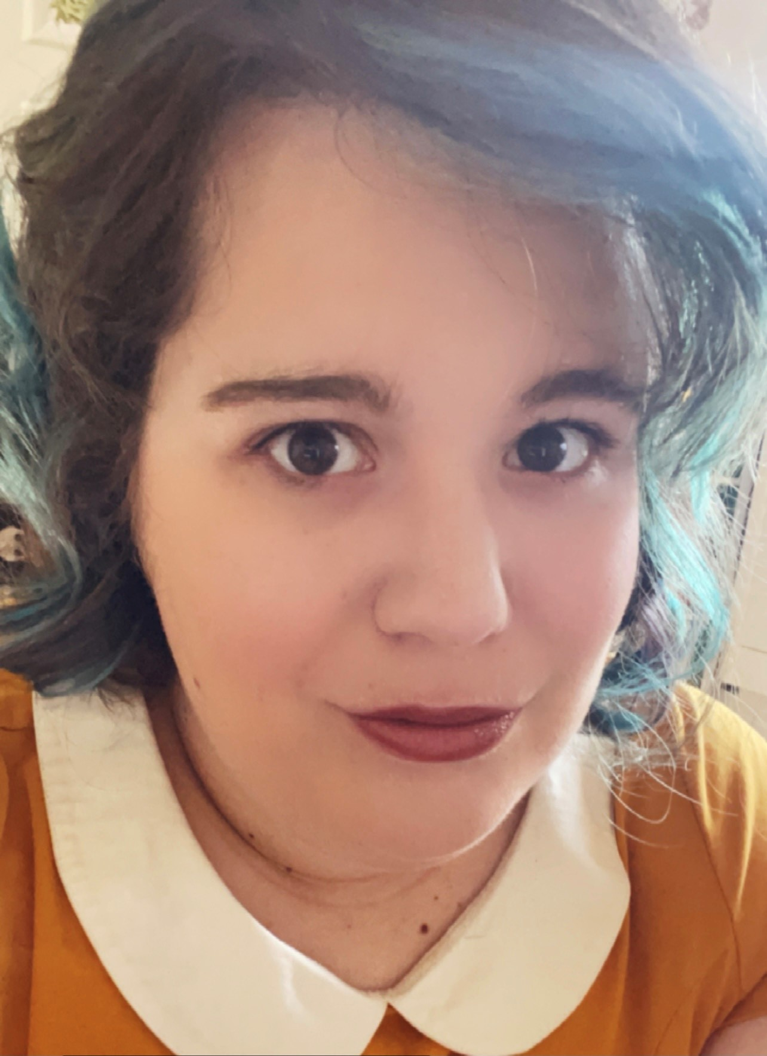
STEM Librarians
Jenni Jacobs
BS,MS,MLIS
STEM Librarian
Texas Tech University
Liaison Areas:
Math and Statistics
Physics
Environmental Toxicology
Forensic Sciences
Geosciences
Kinesiology and Sports Management
Pre-Professional Health
Notes:
My name is Jenni Jacobs and I’ve been in libraries over 9 years. I’ve been a librarian for four of those years. My current job is STEM Librarian where I am the liaison for math and stats, physics, environmental toxicology, forensic science, geosciences, kinesiology and sports management, and pre-professional health.

Slide 3
Jenni’s Story
Notes:
When I first started in libraries I was a graduate assistant while getting my masters in english. I was the english education library assistant where I dealt almost exclusively with english education undergrads and grads at Radford University. After I graduated I got a job as a library associate at Georgia Highlands College where I maned a reference desk for 5-6 hours at a time. Here I would get general library questions (printing, directions, finding a book) but I would also field research questions about using the libraries resources . Though were were a community college I would still get STEM questions which was my first experience doing anything STEM, along with manning the 3D printers/makerspaces at our multiple campuses. When I earned my MLIS I got a job as a marketing and outreach librarian, which does not have a whole lot to do with STEM, but I was for a year or so part of out Research and Instruction Services unit where I was liaison to many different colleges including physics, math, geography, and architecture to name a few. At that time I didn’t think that my experience with reference and instruction would come in handy, but after three years as a marketing and outreach librarian I left Georgia and started work as a STEM Librarian at Texas Tech University.

Slide 4
Filling in the Gaps
Webinars, webinars, webinars
Databases galore
Let the students fill the gaps for you
You’re never alone
Notes:
When I first started as a STEM librarian I thought “well I don’t know why they chose me since I don’t think I can do it”. With a general background in humanities I had little knowledge (and honestly little curiosity) in anything outside of the scope of my studies. In library school, at least for me, they didn’t properly prepare me for the variety of jobs a university librarian is required to do, and didn’t properly manage my expectations. Thankfully as a new STEM librarian there was really only up to go since I was starting from what felt like nothing. The first thing I did was find webinars that I could attend freely to help with my knowledge of my subject areas. I also did research of my own. Since I was a “generalist” at my last position, I had to know a little of everything but a lot of none. So I started to go through the databases I knew little to nothing on and learned them as best as I could. The great thing about working in libraries for a long time is that you get accustomed to the way things are, so searching in databases does differ but not so much that you don’t know what’s going on. One thing that really helped me was letting the students fill in the gaps in knowledge that I had. You don’t have to be extremely knowledgeable in their specific subjects, which is something I had to tell myself a lot starting off. You’re not an expert in their subject, but you’re an expert in finding information so as long as they can explain what they’re looking for, or what their subject is, you can take that information and teach them how to look for it.
Another thing I had to remind myself is that you are never alone. At my previous position I was someone who was in charge of a lot and had few people I could talk with about my work. As a STEM librarian not only are there networks out there to take advantage of but within your own university or college there are people to depend on. Whether it’s information about different departments or the way the university as a whole is run, or help with teaching techniques, your colleagues are a wealth of knowledge you should take advantage of.

Slide 5
STEM Librarians
Erin Burns
BA, MLIS, RYT500
STEM Librarian
Texas Tech University
Liaison Areas:
Whitacre College of Engineering
Notes:
The college of engineering contains the following departments: chemical engineering, civil and environmental engineering, computer science, electrical and computer engineering, industrial, manufacturing and systems engineering, mechanical engineering, and the Bob L. Herd Dept of Petroleum engineering
The courses I work with most heavily are : undergrad includes Engineering Ethics and Communication for Engineers; and the graduate programs

Slide 6
Erin’s Story

Slide 7
Filling the Gaps
Professional Development
Joined ASEE and the ELD
Reading and Reviewing STEM books on NetGalley
Asking the students!
Notes:
Professional Development in the engineering fields, including
Coursera --
Data Science, certificate, r programming
Engineering topics like: basics of electrical engineering, petroleum engineering, mechanical engineering, 10 things every engineer should know
and attending the ASEE conference online in 2021, and being a part of the ELD
researching a lot of the engineering literature on threshold concepts and what students need to succeed in these courses
“to be a teacher in the right sense is to be a learner. i am not a teacher, only a fellow student.” Soren Kierkegard

Slide 8
Making it Work
Notes:
Starting a new career in STEM can be quite scary. But success is something you can definitely have if you’re willing to learn. One of the great things about librarianship is that we’re always learning, and being a STEM librarian is no different. Here are just a couple of things you can do to help yourself in your role as STEM Librarian
Learn about/find different professional organizations for your liaison areas. These can be library focused but you can also expand your knowledge on what’s being talked about in your different areas. If you’re a liaison for biology, look for a biology organization to become a part of, or a listserv to subscribe to, so that you can see what people are talking about not only in the library profession but also in the profession of your liaison area
Get Involved. At Texas Tech we have many different ways to get involved in our liaison areas. One great way is through a group on campus called STEM Core. They work with stem faculty, students, and community members.
ASK-- other professionals and even your own students, possibly even look for a mentor in that particular topic area
Regarding research-- it can be related to STEM education, STEM Librarianship. Read around, see what other people in your liaison area are doing, Erin’s research is some STEM but also a personal project.

Slide 9
“To be a teacher in the right sense is to be a learner. I am not a teacher, only a fellow student.” Soren Kierkegard

Slide 10
Thanks!
Do you have any questions?
erin.burns@ttu.edu
jenni.jacobs@ttu.edu
https://guides.library.ttu.edu/

